Slide 1


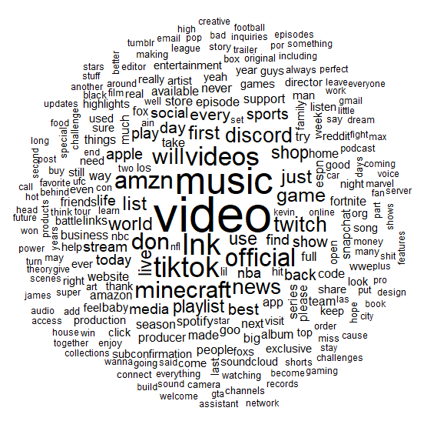
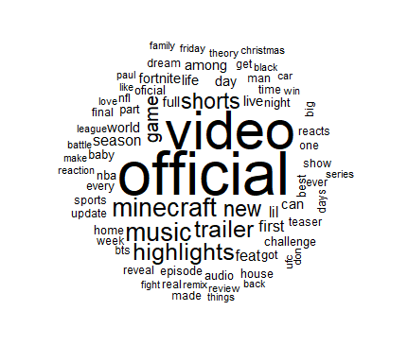
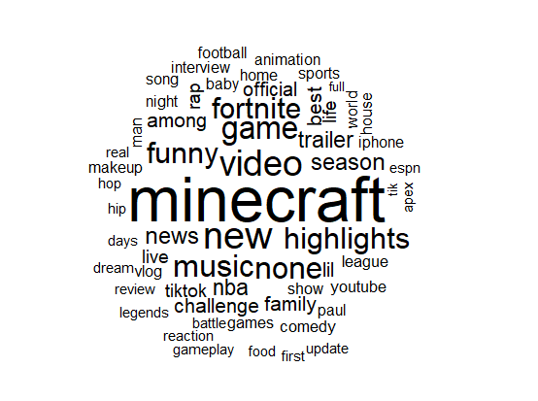
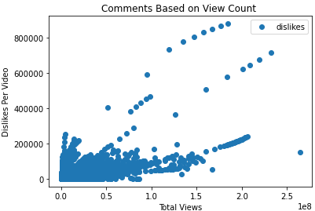
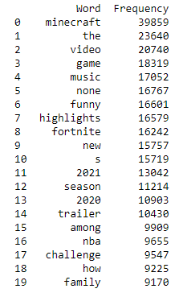
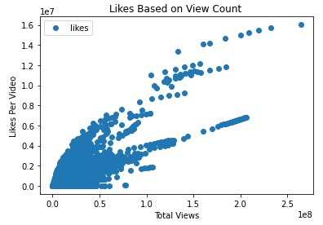
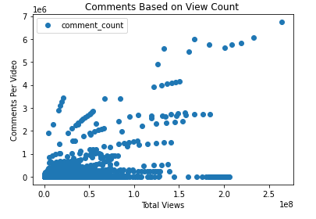
YouTube Trending Video Analysis by Kameron Gilham
Size
The Goal
The goal of this project is to find out which type/genre of YouTube videos end up trending.
Data
The graphs are just a little visualization on the likes, dislikes, and comments based on the number of views.
Trending aims to surface videos that a wide range of viewers would find interesting. Some trends are predictable, like a new song from a popular artist or a new movie trailer. Others are surprising, like a viral video.
Depends on how quickly a video generated views
Description
Titles
Tags
Word Count
Conclusion
With the help of the word clouds, word count, and a little clustering. I was able to generate a rough idea of what the most common genre of videos end up on the trending page the most frequently.
Challenges
Word Cloud
Clustering
Time Management
Underestimating

